Slide 1
CSC4780 – Network security
Instructor: Susmit Shannigrahi
sshannigrahi@tntech.edu

Slide 2
Chapter 1: Fundamentals
Networking is ubiquitous
(Breakout) What did you use it for today?
First things first:
Terminology
Basic tools
What does it take to build an Internet?
Notes:
Ndn can help organizing the namespaces
Once that’s done, data discovery and provenance is
Straight forward
Retrieval, transparent failover, and specialized operations
In this work, we take a real access log and try to quantify NDN’s improvements to a climate
workflow

Slide 3
Links, Nodes, Network, Internet
You can view the network as a graph
Each device (a phone, a computer) is a node
Each connection is a link
Wires = real links
Bluetooth, Radio, Infrared = virtual links
Nodes + links = a network
Many connected networks = Internet
Notes:
Ndn can help organizing the namespaces
Once that’s done, data discovery and provenance is
Straight forward
Retrieval, transparent failover, and specialized operations
In this work, we take a real access log and try to quantify NDN’s improvements to a climate
workflow

Slide 4
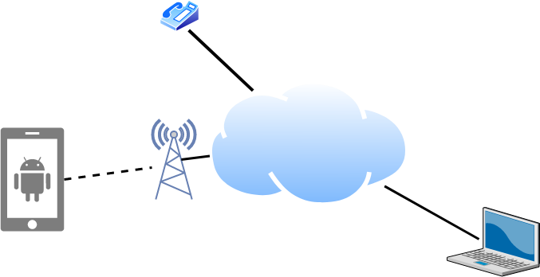
Links, Nodes, Cloud, Routers, Switches
Notes:
Ndn can help organizing the namespaces
Once that’s done, data discovery and provenance is
Straight forward
Retrieval, transparent failover, and specialized operations
In this work, we take a real access log and try to quantify NDN’s improvements to a climate
workflow

Slide 5
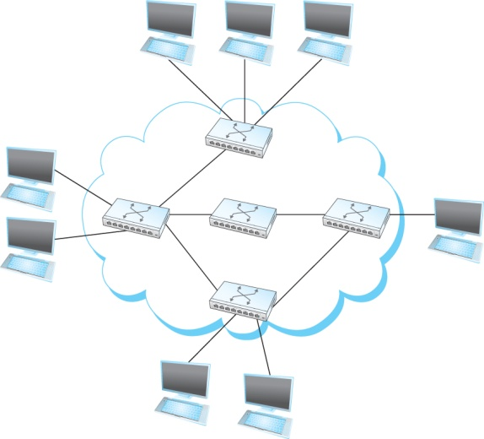
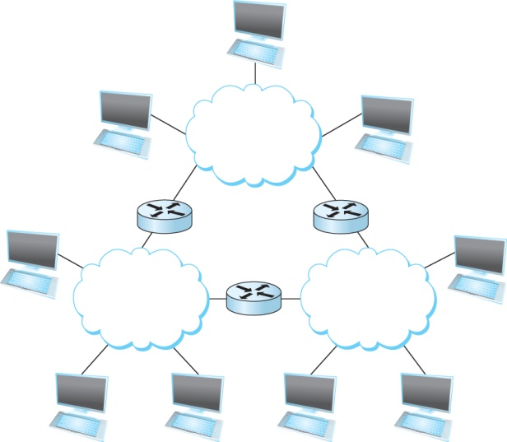
A Network and the Internet
Notes:
Ndn can help organizing the namespaces
Once that’s done, data discovery and provenance is
Straight forward
Retrieval, transparent failover, and specialized operations
In this work, we take a real access log and try to quantify NDN’s improvements to a climate
workflow

Slide 6
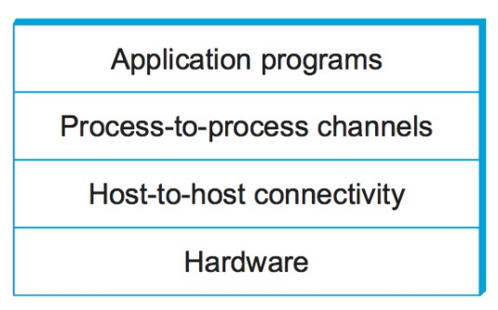
Network Architecture
What are the requirements from a network?
Architecture = High-level blueprint
Protocols = Building blocks of the architecture
Layering = Break down the problem in smaller pieces

Slide 7
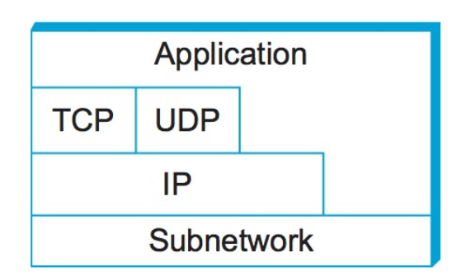
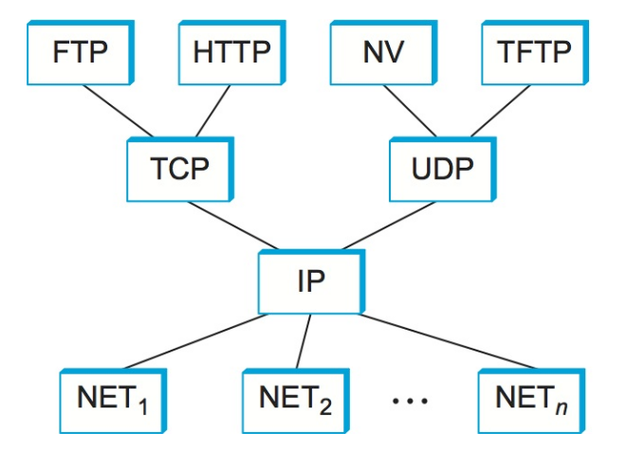
Network Layers
Use Service
Export Service
Makes it easier to divide functionality
Hides implementation details
Breakout – few other reasons?

Slide 8
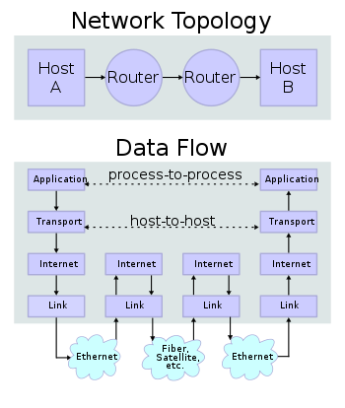
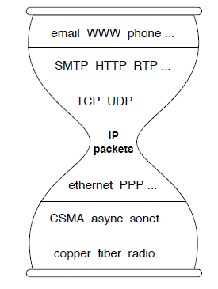
IP Suite
We reject kings, presidents, and voting. We believe in rough consensus
and running code. (David Clark, IETF, July 1992)
wikipedia

Slide 9

TCP/IP Layers
Apps (HTTP)
Data
Apps (HTTP)
Segments
Transport (TCP/UDP)
Transport (TCP/UDP)
Network (IP)
Packets
Network (IP)
Link (Ethernet)
Frames
Link (Ethernet)
Ethernet Interface
Ethernet Interface
Bits (1010001)

Slide 10
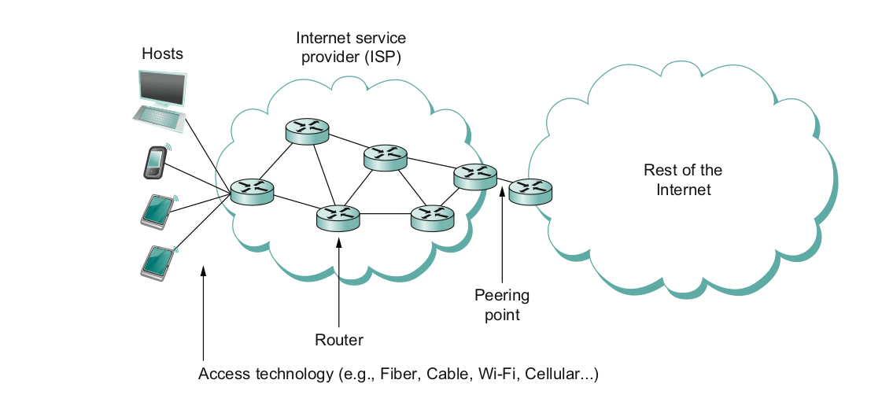
What does it take to create a link?
Common abstractions
Why?

Slide 11
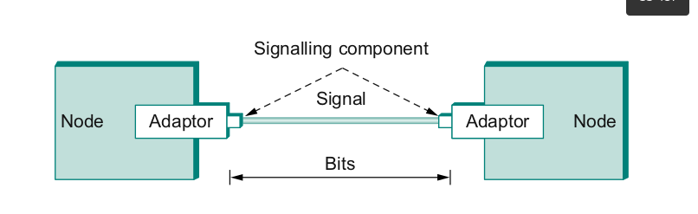
Packet to Low level Signals
Bit pattern - 0101001
Must encode it into electrical signals and then decode it on the other end!

Slide 12
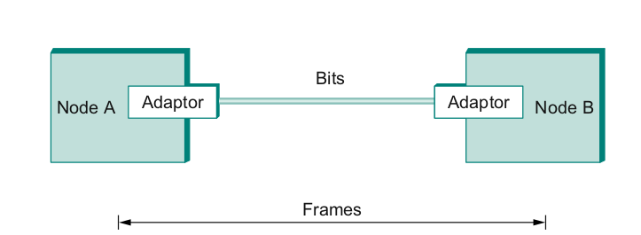
Frames – bag of bits
Bits - between adaptors
Frames – between hosts (two computers)
The job of adaptors is to find frames in a bit sequence
Frames are link layer protocols
Notes:
Ndn can help organizing the namespaces
Once that’s done, data discovery and provenance is
Straight forward
Retrieval, transparent failover, and specialized operations
In this work, we take a real access log and try to quantify NDN’s improvements to a climate
workflow

Slide 13

Requirements:
Packet framing: encapsulation of network-layer datagram in data link frame
Bit transparency: Does not care about what its carrying
Error Detection: Correction is on upper layers
Connection liveness
Network layer address negotiation
Point to Point Links
Notes:
The University of Adelaide, School of Computer Science
24 January 2026
Chapter 2 — Instructions: Language of the Computer
13

Slide 14
Reliable Delivery
Frames might get lost
Too many bits lost
Clock did not sync properly
Error detected but the report got lost
Can we build links that does not have errors?
Not possible
How about all those error correction stuff we learned?
Can we add them to frames?
We could, but think of the overhead
What happens when the entire frame is lost?
Notes:
Ndn can help organizing the namespaces
Once that’s done, data discovery and provenance is
Straight forward
Retrieval, transparent failover, and specialized operations
In this work, we take a real access log and try to quantify NDN’s improvements to a climate
workflow

Slide 15
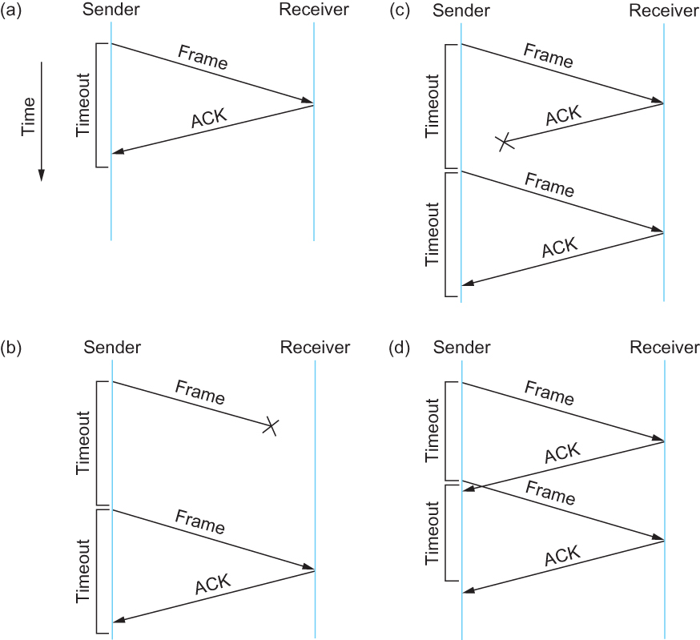
Stop and Wait
Sender sends a frame, sets a timeout (e.g., 1 sec)
Receiver receives the frame,
sends an ACK
Sender
sends the next frame on ACK
retransmits the same frame if timeout happens
If I had to attack this protocol, how would I do it?
Notes:
Ndn can help organizing the namespaces
Once that’s done, data discovery and provenance is
Straight forward
Retrieval, transparent failover, and specialized operations
In this work, we take a real access log and try to quantify NDN’s improvements to a climate
workflow

Slide 16
Ethernet – Wire as Shared Medium
We created a frame – how to use it for communication?
Most successful local area networking technology of last 20 years.
Developed in the mid-1970s by researchers at the Xerox Palo Alto Research Centers (PARC).
For alohanet the medium was the atmosphere, for ethernet, coax cables
Frames
Frames
Notes:
Ndn can help organizing the namespaces
Once that’s done, data discovery and provenance is
Straight forward
Retrieval, transparent failover, and specialized operations
In this work, we take a real access log and try to quantify NDN’s improvements to a climate
workflow

Slide 17
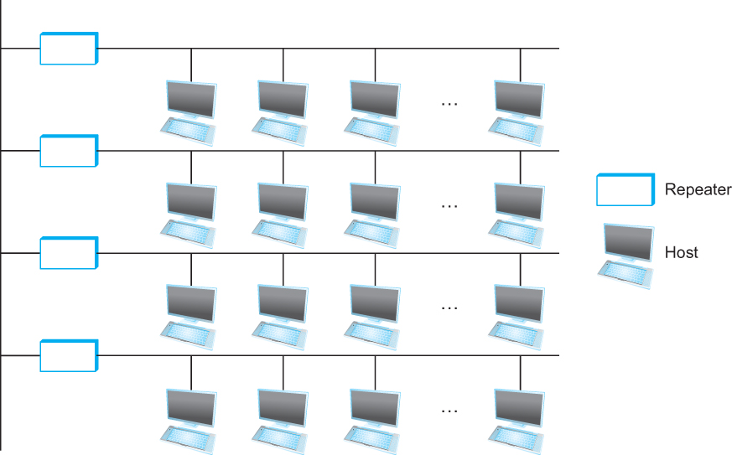
Ethernet
Ethernet repeater
Notes:
The University of Adelaide, School of Computer Science
24 January 2026
Chapter 2 — Instructions: Language of the Computer
17

Slide 18
Ethernet – Random Access
How to allow many adaptors to send frames over the wire?
Random access
When you have data – send at Full channel rate!
No coordination needed.
If collision happens
Detect
Recover
Retransmit
Notes:
Ndn can help organizing the namespaces
Once that’s done, data discovery and provenance is
Straight forward
Retrieval, transparent failover, and specialized operations
In this work, we take a real access log and try to quantify NDN’s improvements to a climate
workflow

Slide 19

Ethernet Frame
SYNC- 7 bytes of 10101010 1 byte of 10101011
Payload
Upper layer protocol
(usually IP)
MAC ADDRESSES
Notes:
The University of Adelaide, School of Computer Science
24 January 2026
Chapter 2 — Instructions: Language of the Computer
19

Slide 20


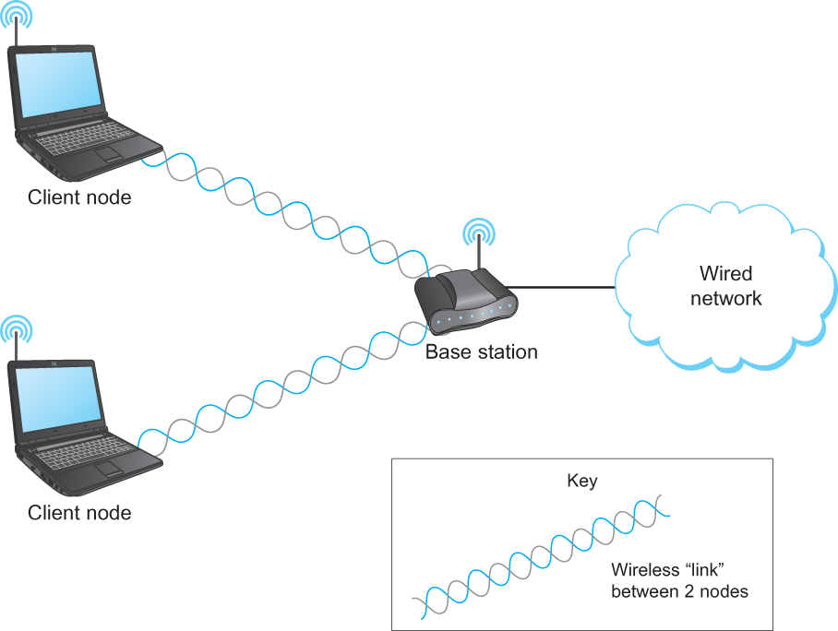
Wireless Links
Typically connects to
Base stations Multiple access Handoff protocols
Wireless != Mobile
A wireless network using a base station

Slide 21





Wireless Links – problems and attacks?
B
Hidden terminal
Signal Fading
C
A
B
C
A
A’s signal
strength
C’s signal
strength
A and C can talk
B and C can talk
A and B can not!!! Interference at B
space
Notes:
The University of Adelaide, School of Computer Science
24 January 2026
Chapter 2 — Instructions: Language of the Computer
21

Slide 22
TCP/IP Layers
Apps (HTTP)
Data
Apps (HTTP)
Segments
Transport (TCP/UDP)
Transport (TCP/UDP)
Network (IP)
Packets
Network (IP)
Link (Ethernet)
Frames
Link (Ethernet)
Ethernet Interface
Ethernet Interface
Bits (1010001)

Slide 23
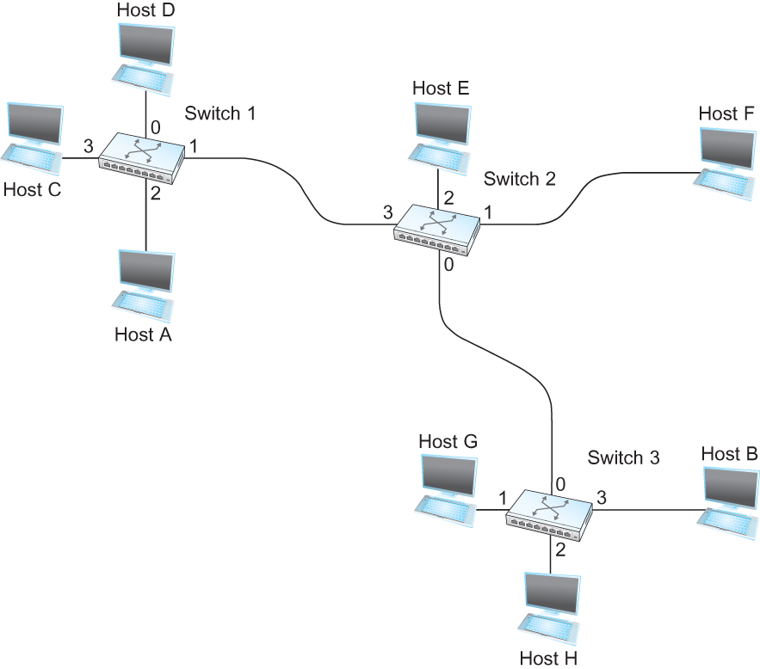
Switching
Switch
A mechanism to interconnect
links to form a large network
Forward frames
Separate the collision domains
Filter packets between LANs
Connects two or more LAN segments - Bridging
LAN 1
Collision domain 1
LAN 2
Collision domain 2
Notes:
Ndn can help organizing the namespaces
Once that’s done, data discovery and provenance is
Straight forward
Retrieval, transparent failover, and specialized operations
In this work, we take a real access log and try to quantify NDN’s improvements to a climate
workflow

Slide 24
Switching Table
To decide how to forward a packet, a switch consults a forwarding table
Destination, Port
-------------------------------------
A 3
B 0
C 3
D 3
E 2
F 1
G 0
H 0
Forwarding Table for Switch 2
Notes:
Ndn can help organizing the namespaces
Once that’s done, data discovery and provenance is
Straight forward
Retrieval, transparent failover, and specialized operations
In this work, we take a real access log and try to quantify NDN’s improvements to a climate
workflow

Slide 25
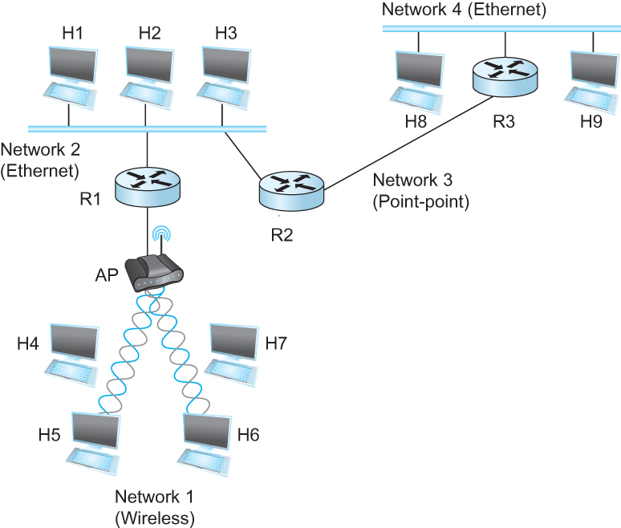
Internet Protocol (IP)
What is an internetwork?
An arbitrary collection of networks interconnected to provide some sort of host-host to packet delivery service
Notes:
Ndn can help organizing the namespaces
Once that’s done, data discovery and provenance is
Straight forward
Retrieval, transparent failover, and specialized operations
In this work, we take a real access log and try to quantify NDN’s improvements to a climate
workflow

Slide 26
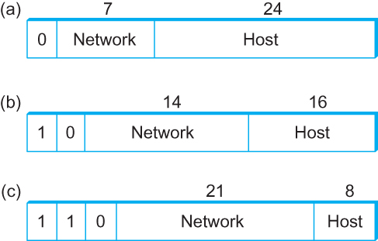
Global Address in IP – Each node has an unique address
A 32 bit number in quad-dot notation
Identifies an Interface
A host might have several interfaces!!!
129.82.138.254
10000001.01010010.10001010.11111110
Notes:
Ndn can help organizing the namespaces
Once that’s done, data discovery and provenance is
Straight forward
Retrieval, transparent failover, and specialized operations
In this work, we take a real access log and try to quantify NDN’s improvements to a climate
workflow

Slide 27
IP addresses are in Network + Host
1.1.2.1 →
1.1 → Network part
2.1 → host part
Each octet can range from 1- 255
Hierarchical address
1.1.2.1
5.1.6.7
1.1.2.2
1.1.*.* | Interface 3
129.82.138.254 10000001.01010010.10001010.11111110
Network part (24 bits). Host part(8 bits)
Notes:
Ndn can help organizing the namespaces
Once that’s done, data discovery and provenance is
Straight forward
Retrieval, transparent failover, and specialized operations
In this work, we take a real access log and try to quantify NDN’s improvements to a climate
workflow

Slide 28
You have an address – Send data now. Problems?
Packet Delivery Model
Notes:
Ndn can help organizing the namespaces
Once that’s done, data discovery and provenance is
Straight forward
Retrieval, transparent failover, and specialized operations
In this work, we take a real access log and try to quantify NDN’s improvements to a climate
workflow

Slide 29
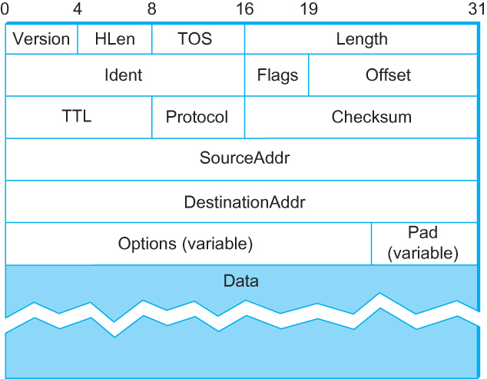
IP Packet
Version (4): 4
Hlen (4): number of 32-bit words in header
TOS (8): type of service (not widely used)
Length (16): number of bytes in this datagram
Ident (16): used by fragmentation
Flags/Offset (16): used by fragmentation
TTL (8): number of hops this datagram has traveled
Protocol (8): demux key (TCP=6, UDP=17)
Checksum (16): of the header only
DestAddr & SrcAddr (32)
Notes:
Ndn can help organizing the namespaces
Once that’s done, data discovery and provenance is
Straight forward
Retrieval, transparent failover, and specialized operations
In this work, we take a real access log and try to quantify NDN’s improvements to a climate
workflow

Slide 30
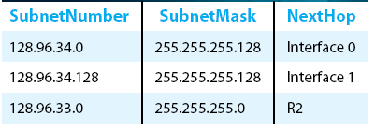
IP Routing
Forwarding:
to select an output port based on destination address and routing table
Local path
Routing:
process by which routing table is built
End-to-end path
Notes:
Ndn can help organizing the namespaces
Once that’s done, data discovery and provenance is
Straight forward
Retrieval, transparent failover, and specialized operations
In this work, we take a real access log and try to quantify NDN’s improvements to a climate
workflow

Slide 31
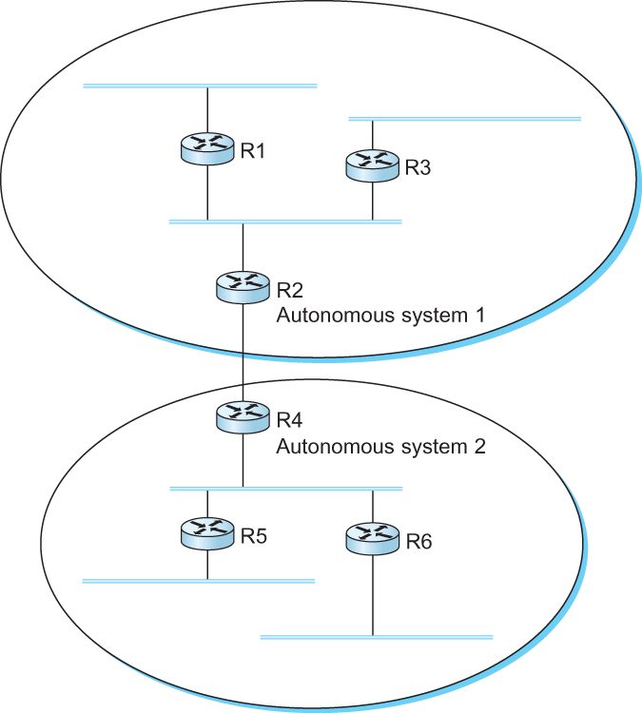
Interdomain Routing
IGP
Interior gateway protocol
IGP
Interior gateway protocol
BGP
Border gateway protocol
IGP
Interior gateway protocol
IGP
Interior gateway protocol
A network with four autonomous systems

Slide 32
BGP: Path vector protocol
Loop!
Path: AS 223, AS 225, AS 245, AS 7770
Path: AS 223, AS 225, AS 245, AS 7770
AS 7770
AS 223
AS 225
Path: AS 223
Path: AS 223, AS 225
AS 245
Path: AS 223, AS 225, AS 245

Slide 33
TCP/IP Layers
Apps (HTTP)
Data
Apps (HTTP)
Segments
Transport (TCP/UDP)
Transport (TCP/UDP)
Network (IP)
Packets
Network (IP)
Link (Ethernet)
Frames
Link (Ethernet)
Ethernet Interface
Ethernet Interface
Bits (1010001)

Slide 34
What is transport layer?
Problem: How to turn this host-to-host packet delivery service into a process-to-process communication channel?
Notes:
Ndn can help organizing the namespaces
Once that’s done, data discovery and provenance is
Straight forward
Retrieval, transparent failover, and specialized operations
In this work, we take a real access log and try to quantify NDN’s improvements to a climate
workflow

Slide 35

















Transport services and protocols
application
transport
network
data link
physical
provide logical communication between app processes running on different hosts
transport protocols run in end systems
send side: breaks app messages into segments, passes to network layer
rcv side: reassembles segments into messages, passes to app layer
more than one transport protocol available to apps
Internet: TCP and UDP
logical end-end transport
application
transport
network
data link
physical

Slide 36
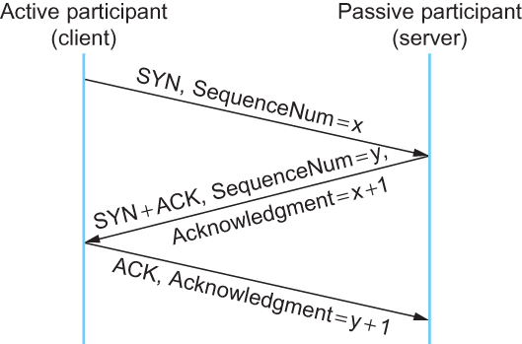
TCP Three-way Handshake
The idea is to tell each other
The ISNs
SYN → Client tells server that
it wants to open a connection,
Client’s ISN = x SYN+ ACK → Server tells
Client → Okay → Server’s ISN = y, ACK = CLSeq + 1 Why increment by 1?
Timeline for three-way handshake algorithm

Slide 37
TCP/IP Layers
Apps (HTTP)
Data
Apps (HTTP)
Segments
Transport (TCP/UDP)
Transport (TCP/UDP)
Network (IP)
Packets
Network (IP)
Link (Ethernet)
Frames
Link (Ethernet)
Ethernet Interface
Ethernet Interface
Bits (1010001)

Slide 38


Client-server architecture
server:
always-on host
permanent IP address
data centers for scaling
clients:
communicate with server
may be intermittently connected
may have dynamic IP addresses
do not communicate directly with each other
client/server
Notes:
38

Slide 39
Securing Data - Application Layer Function
TCP & UDP
no encryption
cleartext passwds sent into socket traverse Internet in cleartext
SSL
provides encrypted TCP connection
data integrity
end-point authentication
SSL is at app layer
Apps use SSL libraries, which “talk” to TCP
SSL socket API
cleartext passwds sent into socket traverse Internet encrypted
More on this later.

Slide 40

Electronic mail
outgoing
message queue
user mailbox
user
agent
Three major components:
user agents
mail servers
simple mail transfer protocol: SMTP
User Agent
a.k.a. “mail reader”
composing, editing, reading mail messages
e.g., Outlook, Thunderbird, iPhone mail client
outgoing, incoming messages stored on server
mail
server
user
agent
SMTP
mail
server
user
agent
SMTP
SMTP
user
agent
mail
server
user
agent
user
agent
Notes:
40

Slide 41
DNS – IP to Name
People: Good with names
Machines: Good with numbers
Ask a person to remember 100s of Ips
- May not work well
DNS maps IP addresses to human readable names.
Notes:
41

Slide 42

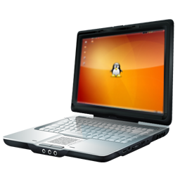
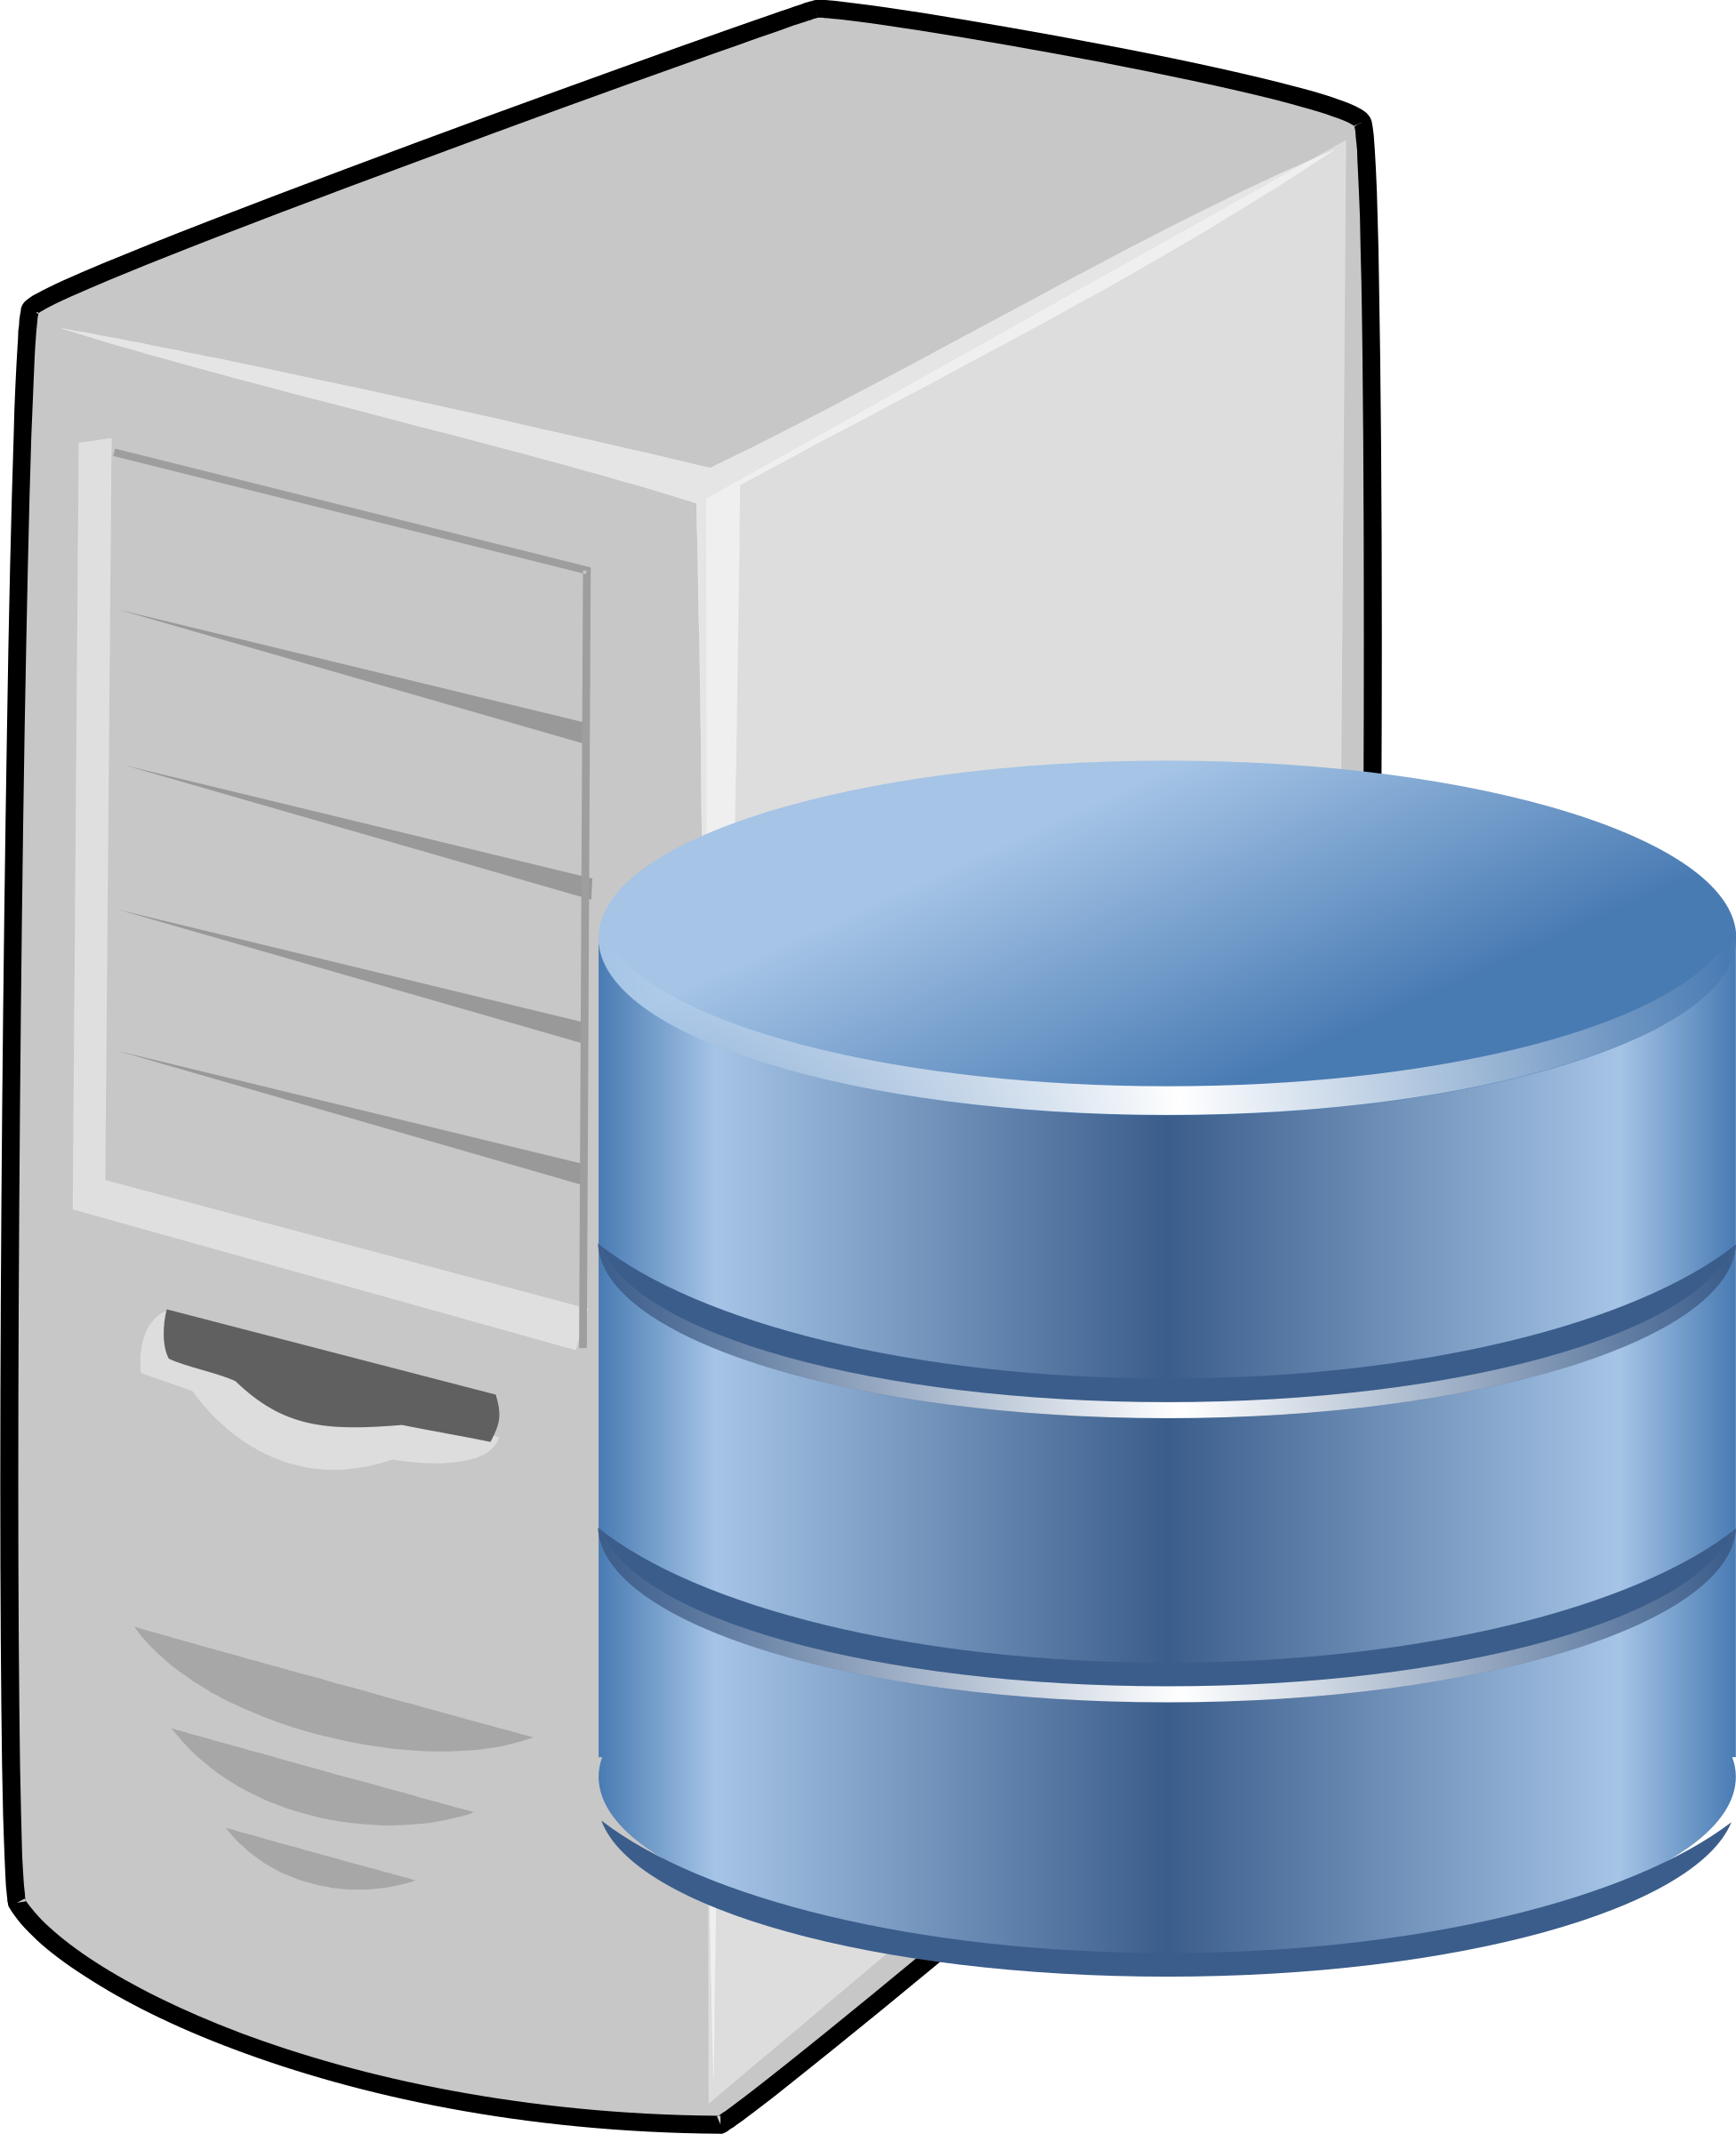

IP Based Communication
google.com
216.58.217.46
GET google.com/index.html
Lookup google.com
216.58.217.46
Get Data
google.com
216.58.217.49
Notes:
Mention interest aggregation
Caching

Slide 43
Summary
- 4 Layers in the network stack
- None of the layers provide security by default
- Security has been always an afterthought
- What are the implications?
- Reading: - Network Security: Private Communication in a Public World
- Chapter 1.8
Notes:
43

